Slide 1
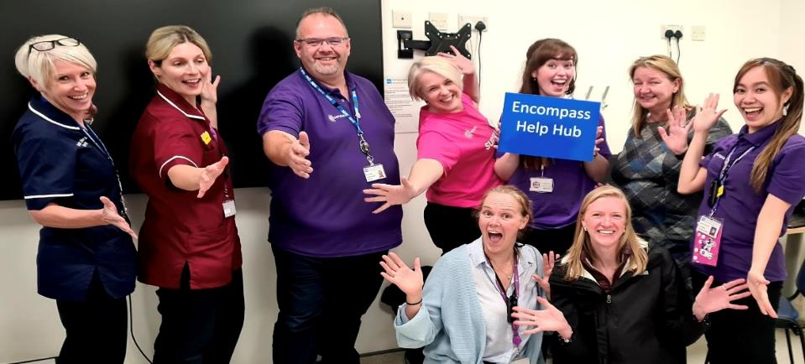
encompass Update
Dr Shane McKee – Consultant Clinical Geneticist & Deputy Chief Clinical Information Officer
Dr Rebecca Gregory – encompass Clinical Fellow

Slide 2
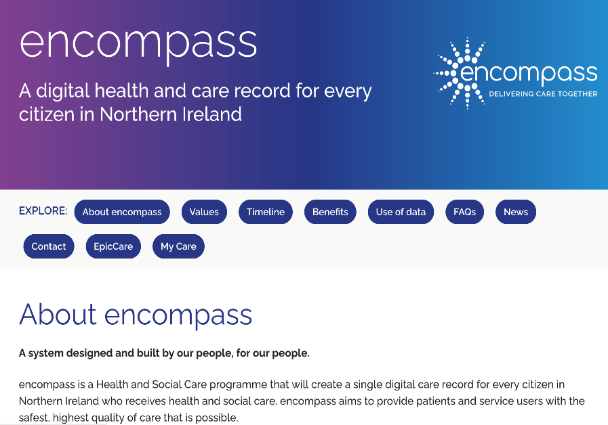
Introduction
Improve patient safety Standardisation Clinically led
Patient and end user empowerment
Digital Transformation

Slide 3
Functional Scope
PAS
BOIS
Patient Portal
Care noting
ePrescribing
Orders
Clinical Decision Support
Workflow support
Population Health Management
Patient Flow
ED
Theatres
Anaesthetics
Intensive Care
Hospital Pharmacy
Community Health
Social Care
Mental Health
Maternity
Child Health
Cancer Pathways
Laboratories
Radiology
General Practice
GP OOHs
Screening

Slide 4

Our partner - Epic
Over 3 million users
Over 100 million client portal users
More than 250 million patient and service user records
Top 20 performing hospitals in US
UK – CUH, UCLH, GOSH, RDE, MFT, Frimley, Guys & St Thomas’, King’s College
The best content is incorporated into the Epic system and shared and updated with the system to all users
The best practices in the world can be easily adopted
Best in KLAS in 2024 for overall software suite for 14th year in a row

Slide 5



The Journey...
Workflow Walkthrough & Configuration
Workflow design & Core Systems Build, Training Curriculum, End User Device Assessment
Training, Go-Live & Stabilisation
Super User & End User Training, Technical Dress Rehearsal, Dry Runs & Cutover, Readiness Assessments, Go-Live
SET Nov 23
BT May 24
NT Nov 24
ST & WT May 25
User & System Readiness
Training environment build, Cutover Planning, Testing & Validation, System Build
Pre-Work
Procurement, Business Case, Contracting, Legacy Data Collection
Optmisation
Additional refinement & development

Slide 6
Digital Health Care and Strategic Board
DHCNI ePMO Board
encompass Regional Programme Board
Finance and Commercial Assurance Board
encompass Regional Delivery & Readiness Board
Trust Programme Boards
Regional Benefits Board
encompass Care Executive
Planning, Performance & Finance Design Authority
Admin Design Authority for Referrals, Pathways & Data Quality
Technical Design Authority
Regional Children’s Oversight Group
Professional Leads Council
Information Governance Advisory Council
Trust Delivery & Readiness Boards
Doctor Advisory Council
Social and Community Care Advisory Council
Primary Care Advisory Council
Joint Negotiation Board
People & Workforce Planning Group
Pharmacy Advisory Council
Nursing & Midwifery Advisory Council
Builder’s Advisory Council
Divisional / Service Readiness Groups
encompass Engagement Council
My Care
Allied Health Professionals Advisory Council
Trust Programmes
Key
Focused Content Design Groups (eFCDGs)
Design Groups
(eDGs)
Interfaces with
Reports/escalates to
Notes:
Version 6.0 – Adjusted to include the establishment of the My Care group

Slide 7
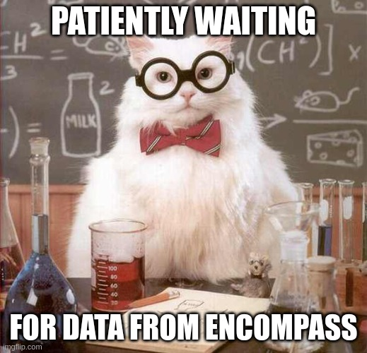
Encompass & Laboratories
NIPIMS project – CliniSys WinPath Enterprise
Place orders for lab tests within encompass
Scan patient barcode, acquire specimen, generate labels
Apply label to specimen, dispatch to lab
Data transfers from encompass --> LIMS
Lab process sample, generate report
Report --> encompass --> Inbasket, Patient Record, MyCare*

Slide 8
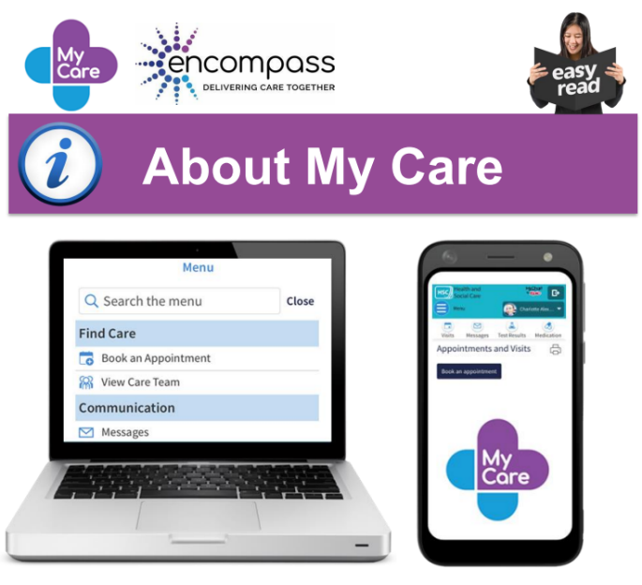


My Care – public info
As a service user, MyCare has been transformational. I am a patient in 3 Trusts and see consultants from multiple specialties. For 2 Trusts I have all my appointments, summaries and test results in one place. Furthermore, I have notifications of new messages / results and appointments. It is empowering as a patient to have an element of control but also to have the information I need relevant to my care. MD

Slide 9

Potential for MyCare in N.Ireland The features below are not available in MyCare but are often enabled in similar organizations
Patient Reported Outcomes
Research study recruitment
Document E-Signature
E-Consults
Patient home monitoring / Patient-entered flowsheets
MyChart Applications (self-referrals)
Care companion
MyChart Bedside
Multilingual support
Patient photos
Integrated video visits
Patient-Initiated Messaging
Medication renewal
Direct scheduling, Ticket Scheduling, Fast-Pass & appointment requests
Appointment confirmation (requires text vendor)
Appointment cancellation for follow up visits

Slide 10

Where are we now?
2 successful Go-Lives complete
Medical Information Officers, Professional Leads, Transformation Leads
Final preparations for Northern trust go live 7th November
Go-Live date agreed for Southern & Western (May 2025)
encompass learning being shared globally
Business as Usual planning underway
First benefits report planned for September
Over 45k registered users of My Care
COMPLEX transformation! Encompass, NIPIMS Core LIMS, NIPACS, NIDIS – a major overhaul of our IT estate

Slide 11
encompass – Making the system your own

Slide 12
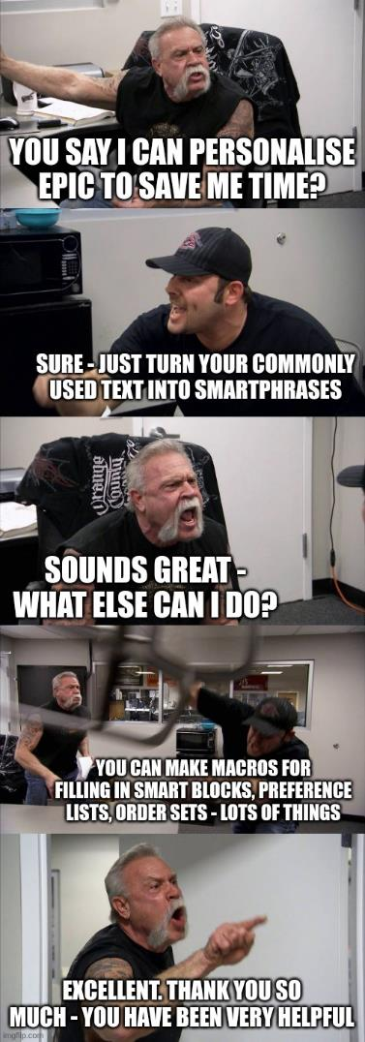
Personalising encompass for your clinical practice
Find your order sets
Set your defaults for prescriptions and note templates
Learn how to write efficient notes using SmartPhrases
Find your patient lists
Build your clinic schedule
WHY?
EHR satisfaction audit surveys indicate users who ‘personalise’ are 2x as likely to say their EHR works for them
Time efficiency savings
Personalisation pre-live ~ more rapid stabilisation post-live

Slide 13

Supporting colleagues who are struggling
Not everyone is going to find this easy
Training is crucial
… so is open-mindedness, kindness, collaboration
Best results from teams working together
Sharing experience, tips, smart tools
Redefining roles & service design
Concentrating on delivering care as a team
Discussing with colleagues outside the team, Trust leadership, encompass crew

Slide 14

It takes a village...
Medical, Nursing, Pharmacy, AHPs
Social workers, Community teams
Trust management, HR, Finance
ICT, Estates, Porters, Catering, DS
Administrative staff, Unions
Patients, Carers, Relatives
Department of Health
GPs, Universities
encompass & Epic teams
(apologies for glaring omissions!)

Slide 15

